Slide 1
CSE3100
Software Development IV
Web Development

Slide 2
Agenda
Bootstrap Setup
Layouts
Forms
Components
Utils

Slide 3
Download
Download link: https://getbootstrap.com/docs/5.0/getting-started/download/

Slide 4
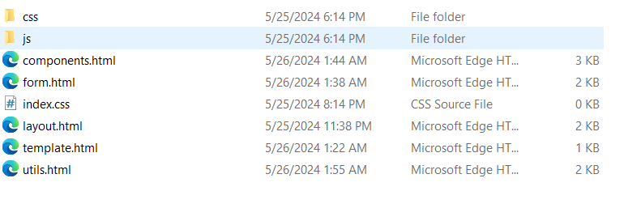
Setup
Extract the downloaded file and put css and js folder inside your project.

Slide 5
Setup
Add this in head setion: <link rel="stylesheet" href="css/bootstrap.min.css"></link>
Add this in the bottom of the body: <scrip scr="js/bootstrap.bundle.min.js"></scrip>

Slide 6
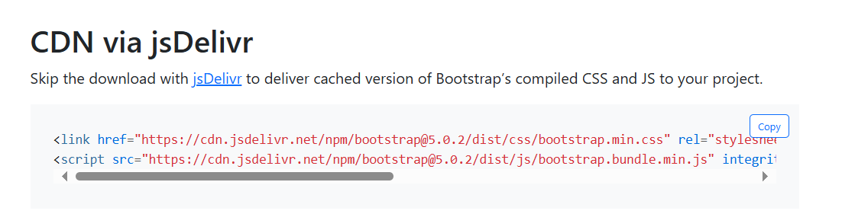
Setup without downloading
Go to the download link and copy this:

Slide 7
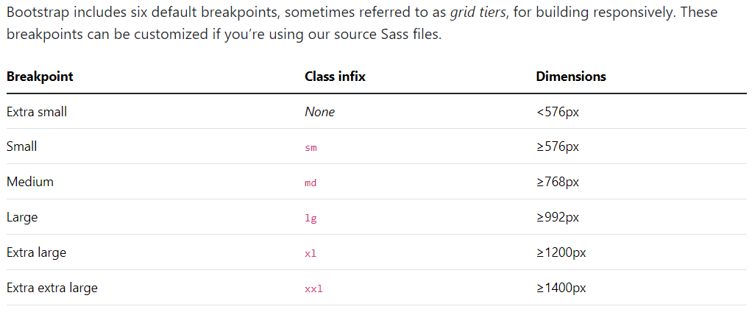
Available Breakpoints

Slide 8
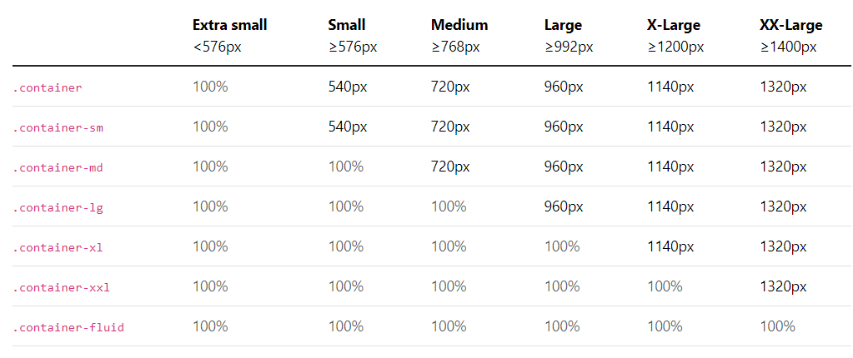
Container

Slide 9
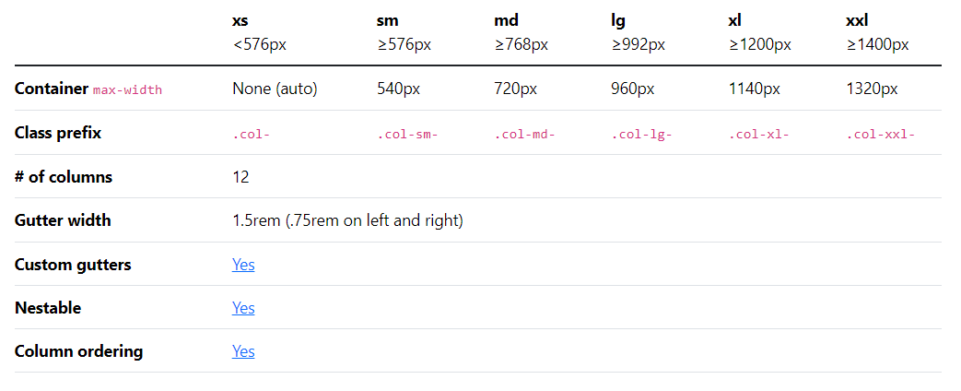
Grid

Slide 10
Forms
form-label
form-control
form-check
form-check-label
form-check-input
etc..

Slide 11
Components
alert
buttons
button group
spinner
Navbar
etc..

Slide 12
Utils
Backgroung
Border
Colors
Spacing
Text
Display
etc..

Slide 13
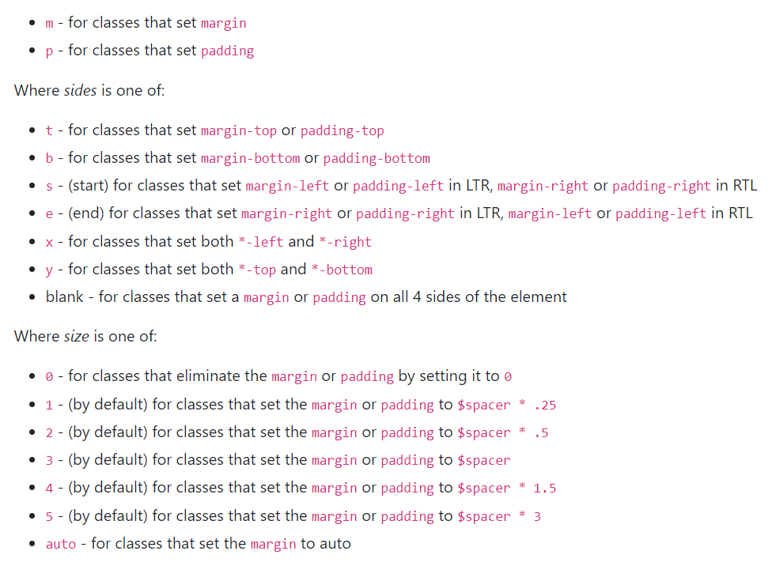
Spacing

Slide 14
Reference
Official Documentation: https://getbootstrap.com/docs/5.0/getting-started/introduction/

Slide 15
Practice
Let’s implement the above learnings.

Slide 16
Thank You
Any Question?

